Slide 1
T23-SP-A
Shallow Heat Assessment
Cole Heap, P.G.

Slide 2

From CalGEM
Thanks for providing the temperature surveys for the requested observation wells. For TO well JB1-26S could you please provide the historical temp surveys mentioned so CalGEM has documentation of the shallow heat subsiding over time? Could you also provide historical temp surveys for TO well MS-1 (0402937030) as well? I agree the temp surveys provided do not support a regional shallow heat anomaly. However, the two TO wells do show shallow temperature anomalies in the overburden indicating heat migrated out of zone. These wells are approximately 1,160’ distance from each other and on opposite sides of the Tulare structure suggesting two separate migration events. The response for MS1-26S’s shallow heat anomaly coming from nearby well 5513U-26S due to a shallow casing hole isn’t supported by CalGEM records which show the well hasn’t been on steam since 2005. There is no other evidence (RA surveys, temp surveys, workovers, etc.. ) supporting this claim.

Slide 3
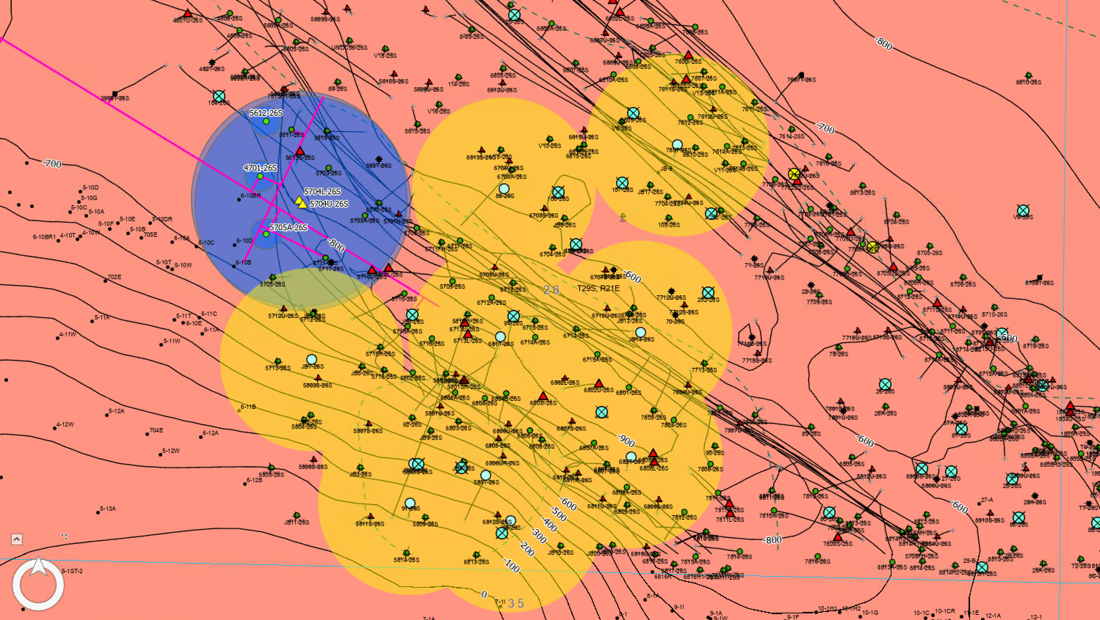
Area of Interest
Notes:
From Cole Heap (12/178/2025): “…[H]ere is that screenshot showing the PCWs in proximity to this project. The cyan with an "X" through them are all wells flagged by Aera as substandard abandonments...the yellow circles are 300ft buffers around the wells CalGEM named and are temperature observation wells. The Blue circles are the ZEI for the proposed injectors represented by yellow triangles. While this is not directly pertinent to the T23-SP-A AOR, although CalGEM seems to be making it so, it would be nice to have some assistance from the RMT to assess the PCWs and whether or not any of those are the source of the shallow heat shown in two of the CalGEM-named observation wells.”

Slide 4
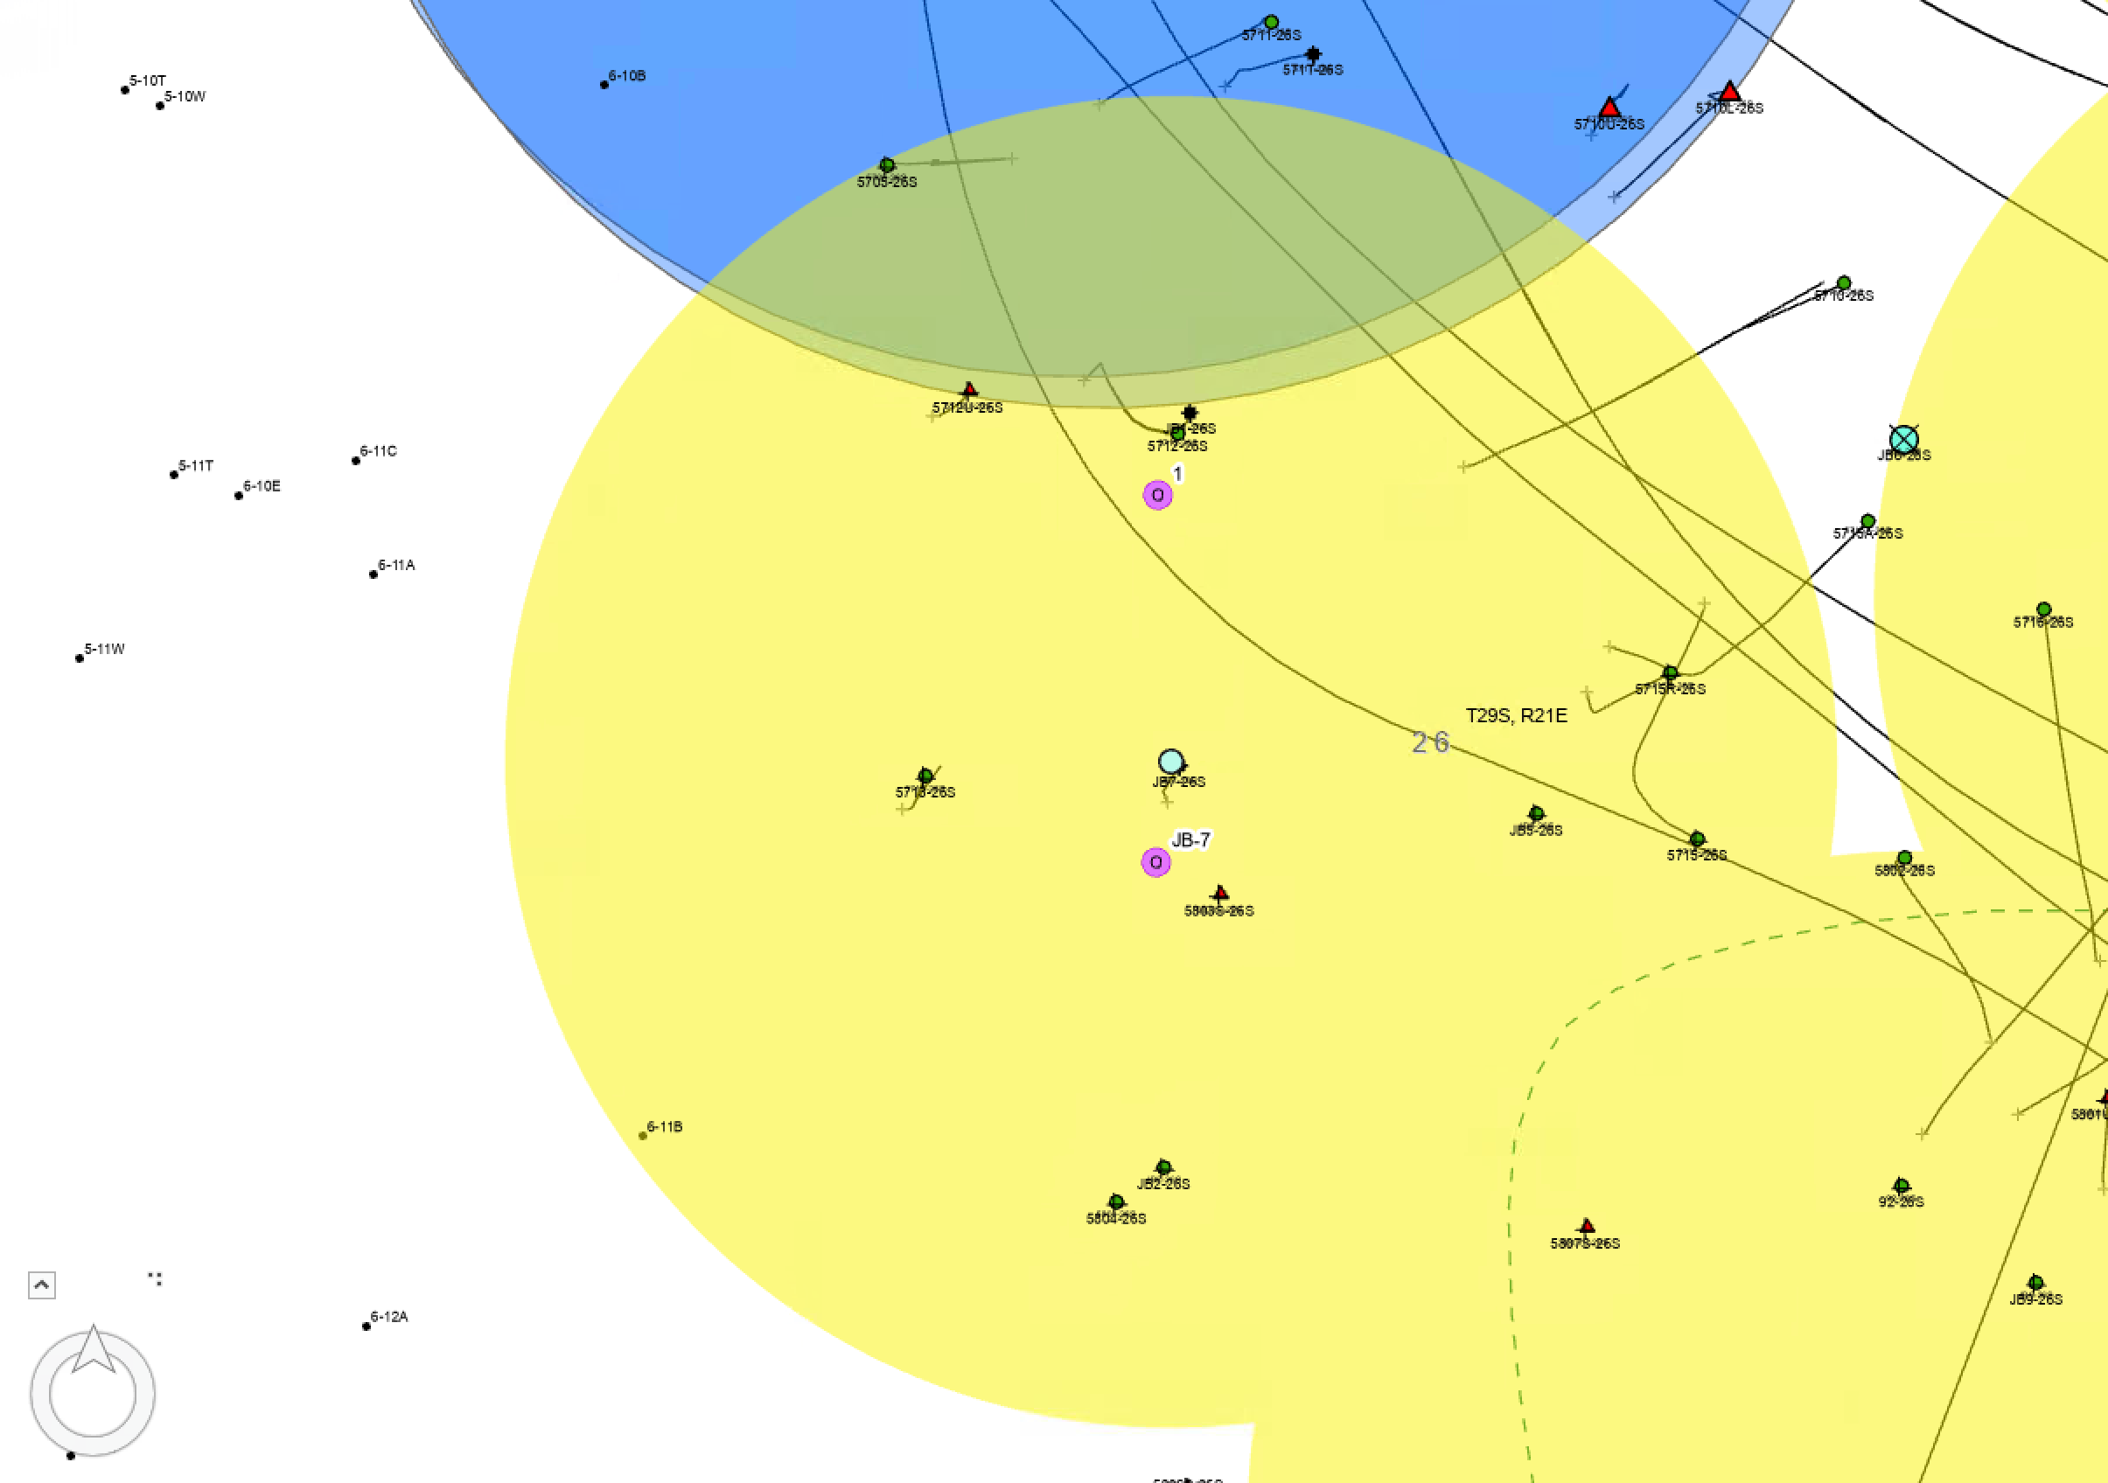
JB7-26S

Slide 5
JB7-26S (0402949610)
300’ Radius was generated around this well location
Distance from JB1-26S: ~160 ft
Abandonment Date: Started 8/23/2024 (not yet designated as complete in OpenWells)
CalGEM witnessed and approved full P&A on 10/24/2024

Slide 7
JB1-26S

Slide 8
JB1-26S (0402948872)
Distance from JB7-26S: ~160 ft
Distance from 5704U-26S (proposed injector): ~357 ft
Released for abandonment on 7/23/2025
Temperature survey in December 2025 shows possible decrease in temperature; however, fluid level at the time of the survey is at 350’ showing a possible hole in the casing and an unreliable temperature survey above the FL depth
Well is ~4 ft from ZEI edge for injector 5704U-26S
Well is ~ 19 ft from ZEI edge for injector 5704L-26S
On 9/20/2017, while running a CNL, vendor could not get past 730 ft

Slide 10
5712U-26S

Slide 11
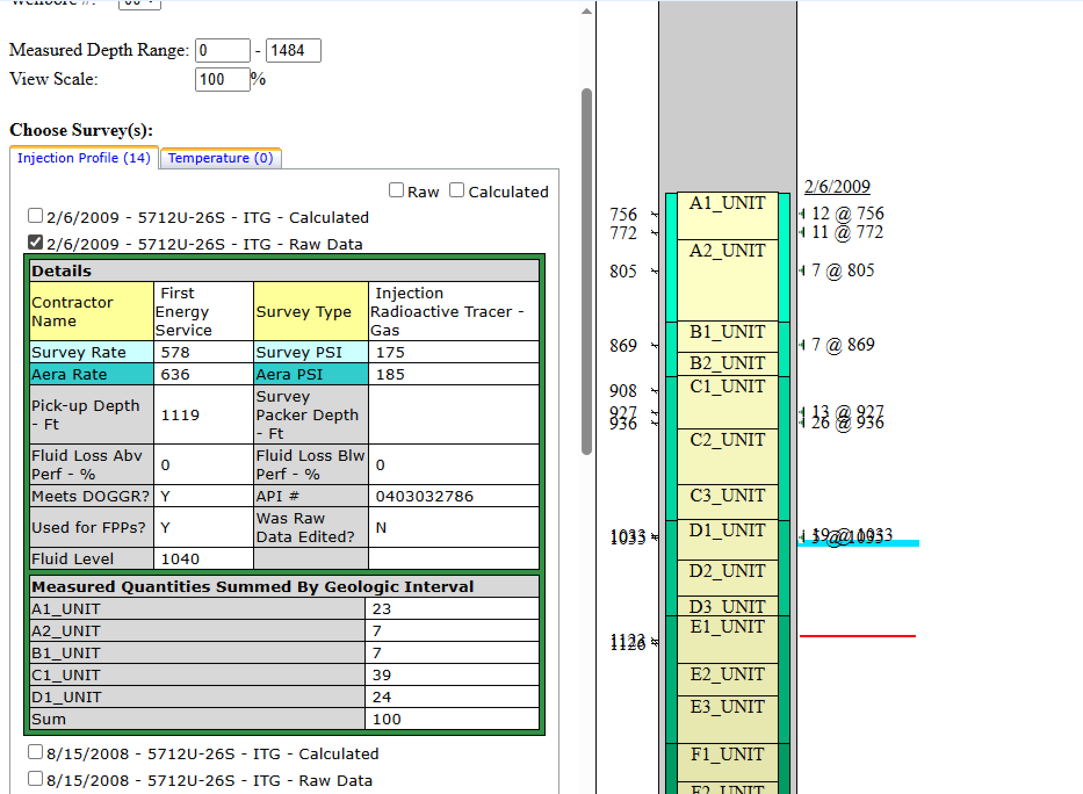
5712U-26S (0403032786)
Distance from JB1-26S: ~100 ft
Abandonment Date: 11/05/2019
Cement to surface on abandonment, no issues or cement fallback
*No history of failed injection profiles or injection out of zone

Slide 12
5712U-26S

Slide 13
5713-26S_ST1 (0402979560)
Distance from JB7-26S: ~110 ft
Distance from JB1-26S: ~202 ft
Abandonment Date: 10/29/2019
Cement to surface on abandonment with no fallback

Slide 14
5712-26S_ST1

Slide 15
5712-26S_ST1 (0402979733)
Drill Date: 5/1/1987
Good cement returns to surface
Distance from JB7-26S: ~148ft
Distance from JB1-26S: ~10 ft
Active well
Suspected holes in casing that were never confirmed (6/3/2020)
On the “Do Not Steam List”
Last steamed in March 2013
Notes:
This well had issues with the underreamer breaking off up high in the injection zone, but nothing abnormal or that the driller could not resolve.

Slide 16
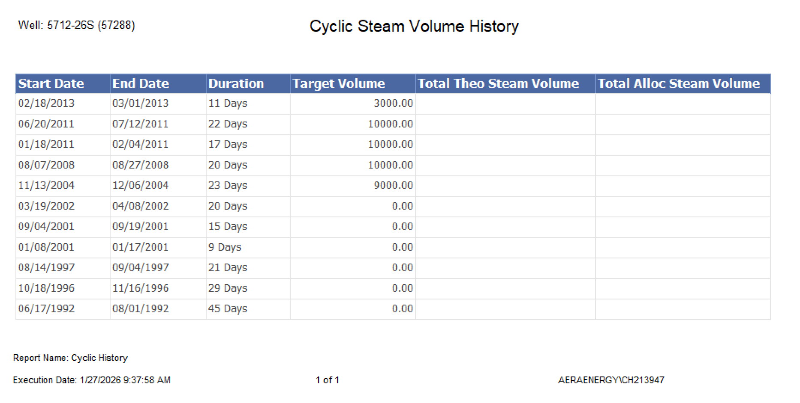
5712-26S_ST1 (0402979733)

Slide 17
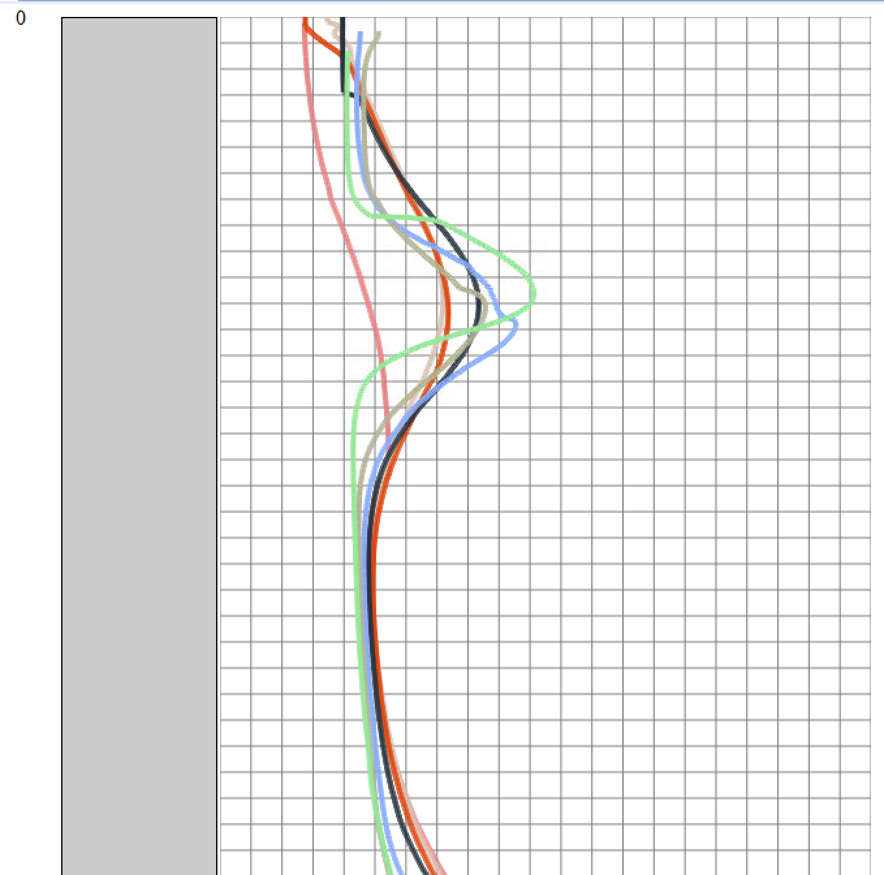




JB1-26S Temperature Surveys
2025
2022
2022 Cyclic event from 5712-26S_ST1near 215’
2021
2017
2012
2007
All other cyclic events are 8 months to a year after all subsequent temperature surveys
2002
Note how cooling has occurred in JB1-26S since 5712-26S_ST1 was placed on the “Do Not Steam List”

Slide 18
MS1-26S Assessment

Slide 19
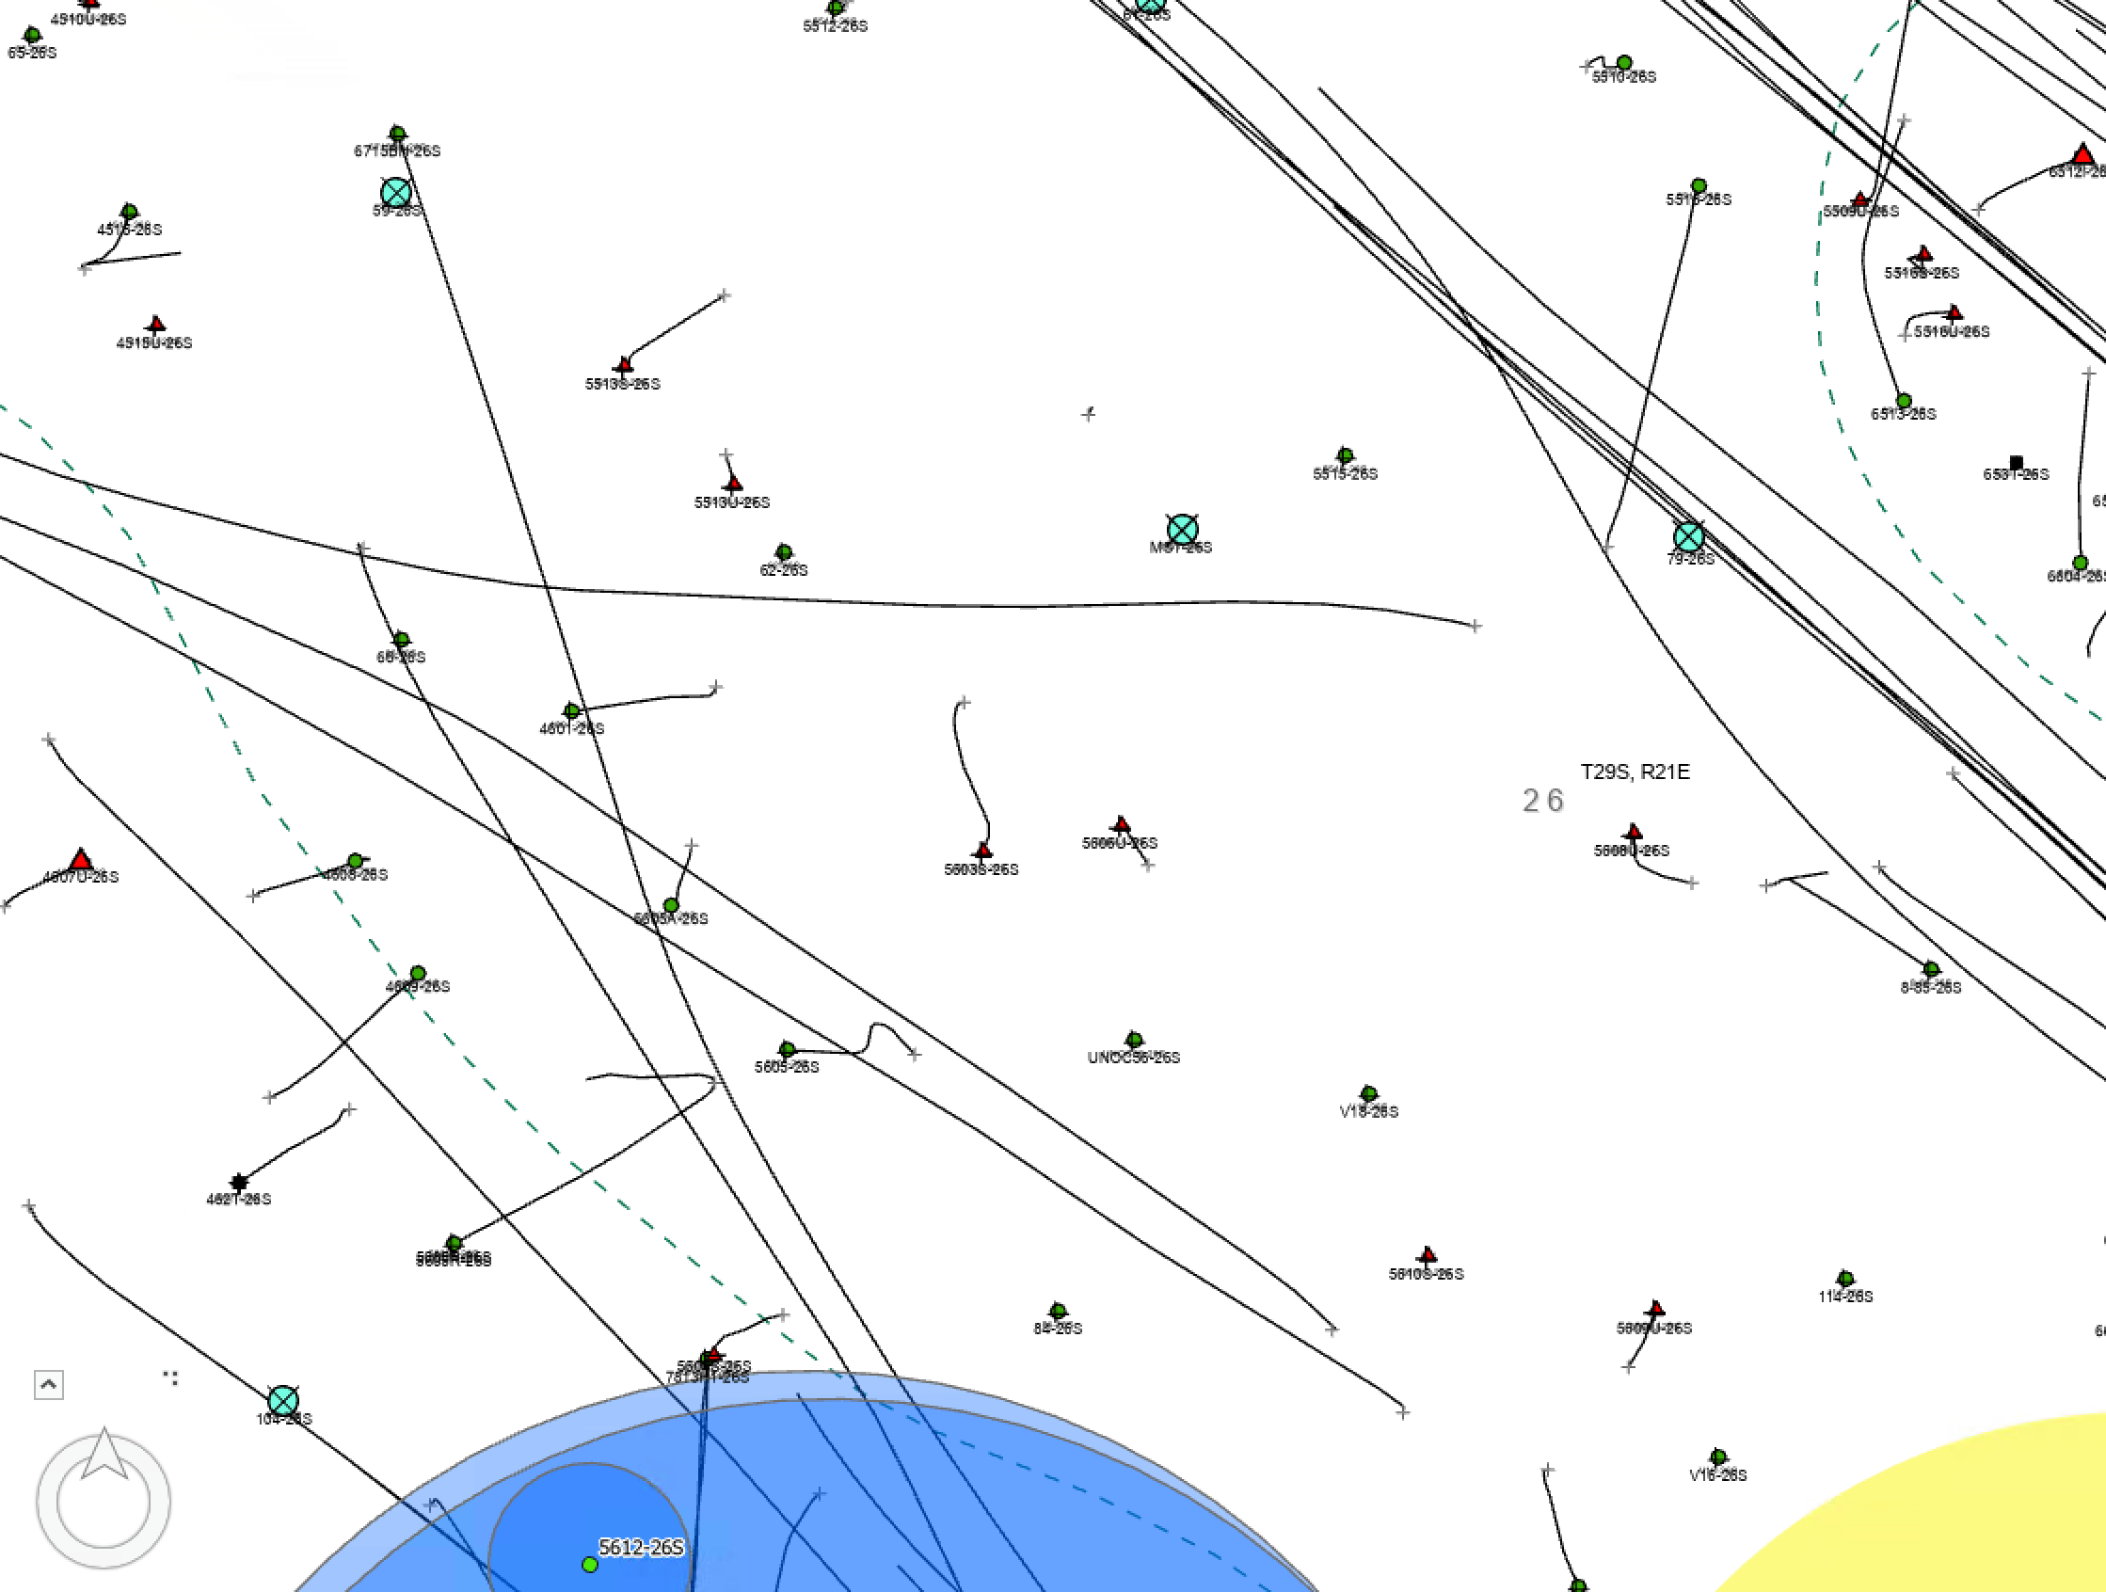
MS1-26S

Slide 20
MS1-26S (0402979733)
Drill Date: 3/1/1940
Converted from O&G producer to TOW on 3/18/1987
Distance to closest continuous injector: ~490 ft | 6512i-26S
Well is already flagged internally as a substandard well due to no cement in annulus
Abandonment Date: 6/25/2025
Shallow heat may have started as early as 2015 (8/24/2015 temp survey)
Only one other temp survey was conducted after that (9/14/2021)
CPT in 2020 states “7/24 Pengo performed CPT. On arrival surface pressure was 0 PSI…Test PASSED.”

